Slide 1
INTRODUCTION TO Programming
Programming Fundamentals (CSC103)
Lecture 2
Instructor: Yasher Ali

Slide 2
Recap
Constant
Variable
Keywords
Rules for variable names
Rules for constant
Rules for real numbers

Slide 3
Form of a C Program
Form of a C program indicates how it has to be written/typed. There are certain rules about the form of a C program that are applicable to all C programs. These are as under:
Each instruction in a C program is written as a separate statement.
The statements in a program must appear in the same order in which we wish them to be executed.
Blank spaces may be inserted between two words to improve the readability of the statement.
All statements should be in lower case letters.
Every C statement must end with a semicolon ( ; ). Thus ; acts as a statement terminator.

Slide 4
printf( ) and its purpose
C does not contain any instruction to display output on the screen.
All output to screen is achieved using readymade library functions.
One such function is printf( )
For us to be able to use the printf( ) function, it is necessary to use #include <stdio.h> at the beginning of the program.
#include is a preprocessor directive.

Slide 5
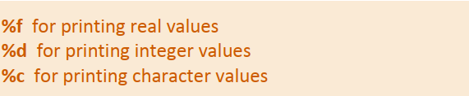
printf( )cont…
The general form of printf( ) function is
<format string> can contain,
In addition to format specifiers like %f, %d and %c, the format string may also contain any other characters.
These characters are printed as they are when printf( ) is executed.

Slide 6
printf( )cont…
printf( ) can not only print values of variables, it can also print the result of an expression.
An expression is nothing but a valid combination of constants, variables and operators.
Thus, 3, 3 + 2, c and a + b * c – d all are valid expressions.
The results of these expressions can be printed as shown below.
Note that 3 and c also represent valid expressions.

Slide 7
Data Types?
In C programming, data types are declarations for variables. This determines the type and size of data associated with variables. For example,
int myVar;
Here, myVar is a variable of int (integer) type. The size of int is 4 bytes.
Variable is an identifier which identifies a value.
In C, data types are
char
int
float
double

Slide 8
Basic types
Here's a table containing commonly used types in C programming for quick access.
Data type | Memory Size | Range | Format Specifier
char | 1 byte | 0-255 | %c
short | 2 byte | -32768 to 32767 | %hd
int | 4 byte | -2147483648 to 2147483647 | %d, %i
unsigned int | 4byte | 0 to 4294967295 | %u
float | 4 byte |  | %f
double | 8 byte |  | %lf

Slide 9
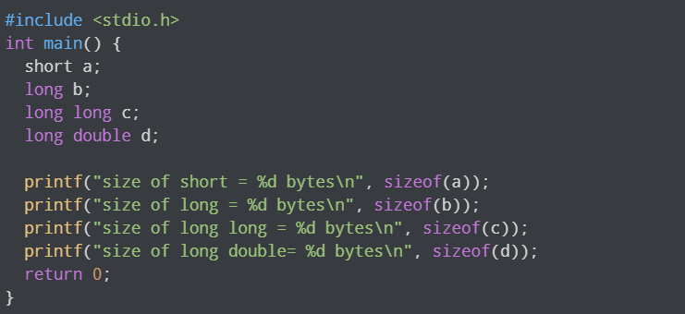
sizeof() operator
You can always check the size of a variable using the sizeof() operator.

Slide 10
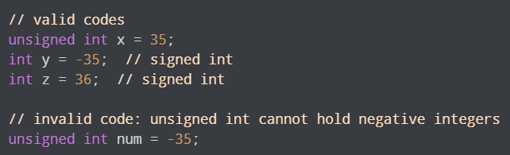
signed and unsigned
In C, signed and unsigned are type modifiers.
You can alter the data storage of a data type by using them:
signed - allows for storage of both positive and negative numbers
unsigned - allows for storage of only positive numbers.

Slide 11
Derived Data Types
Data types that are derived from fundamental data types are derived types. For example: arrays, pointers, function types, structures, etc.
We will learn about these derived data types in upcoming lectures.
bool type
Enumerated type
Complex types

Slide 12
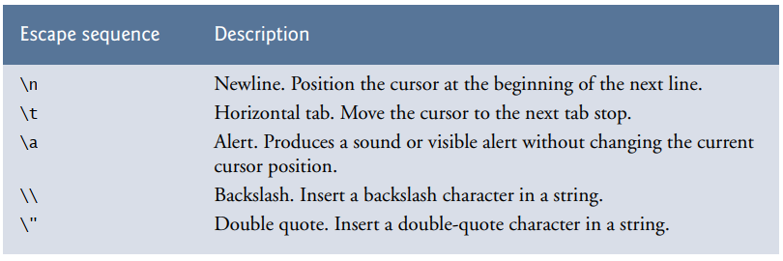
Escape Sequences
When encountering a backslash in a string, the compiler looks ahead at the next character and combines it with the backslash to form an escape sequence.
The escape sequence \n means newline.
When a newline appears in the string output by a printf, the newline causes the cursor to position to the beginning of the next line on the screen.
Some common escape sequences are listed in Fig.

Slide 13
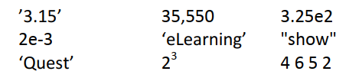
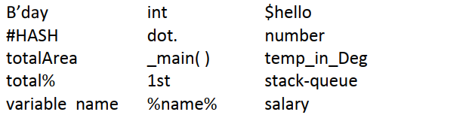
Exercise
Which of the following are invalid C constants and why?
Which of the following are invalid variable names and why?

Slide 14
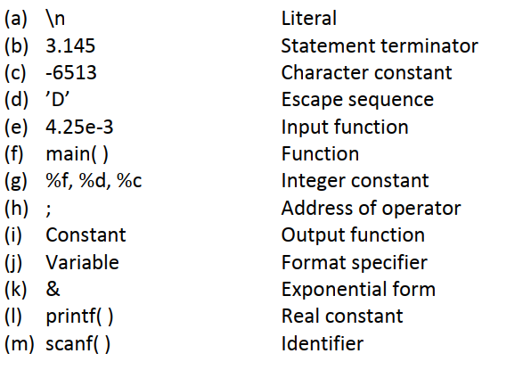
Exercise
Match the following

Slide 15
Summary
Constant is an entity whose value remains fixed.
Variable is an entity whose value can change during course of execution of the program.
Keywords are special words whose meaning is known to the Compiler.
There are certain rules that must be followed while building constants or variables.
The three primary constants and variable types in C are integer, float and character.
We should not use a keyword as a variable name.
Comments should be used to indicate the purpose of the program or statements in a program.
Comments can be single line or multi-line.

